Slide 1
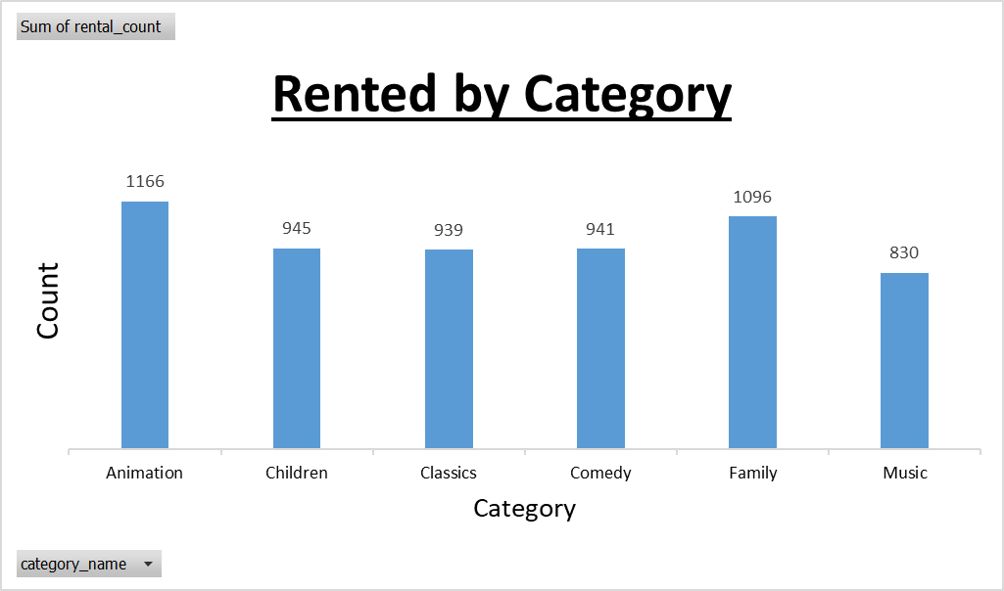
Q.1 Which movie category are families watching the most?
The bar chart displays that among the 6 categories (music, family, comedy, classics, children animations)
Animation had the highest rent count with 1,166 and second heist ranked is Family with 1,096 rent count.

Slide 2
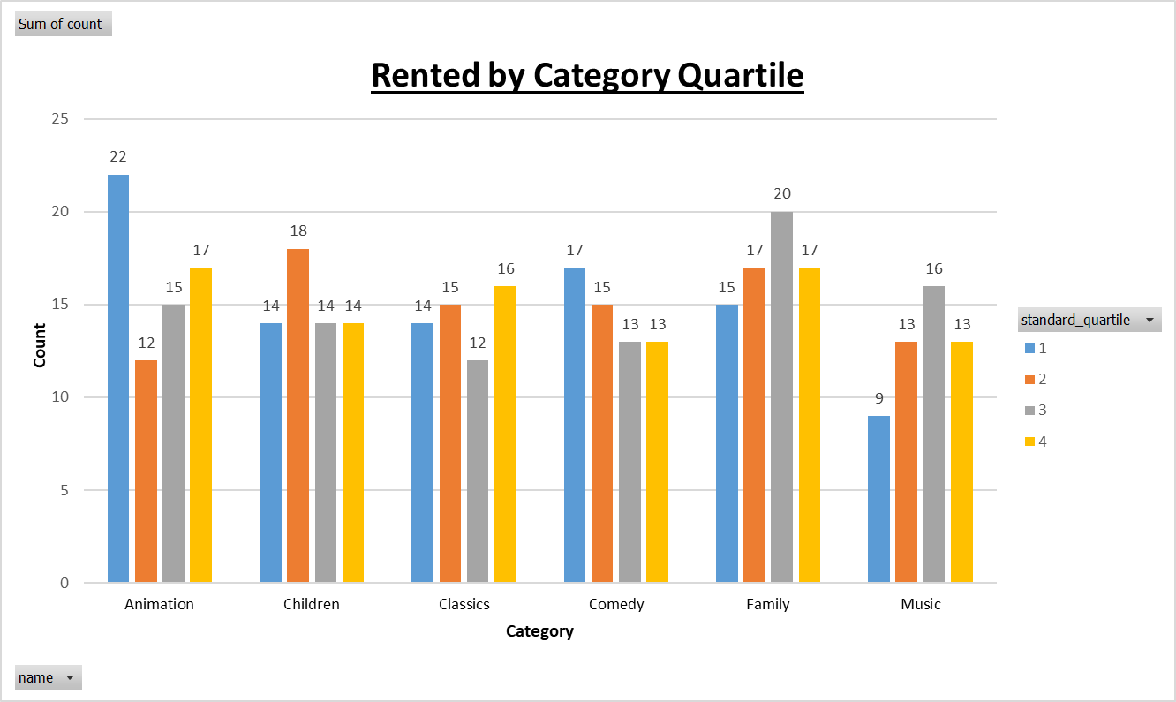
Q.2 Provide a family-friendly film category, each of the quartiles, and the corresponding count of movies within each combination of film category for each corresponding rental duration category.
For rent duration Family is in 1st place followed by Animation.
Within Family the 3rd quartile has the highest with 20 counts
For Animation the 1st quartile had the highest count with 22

Slide 3
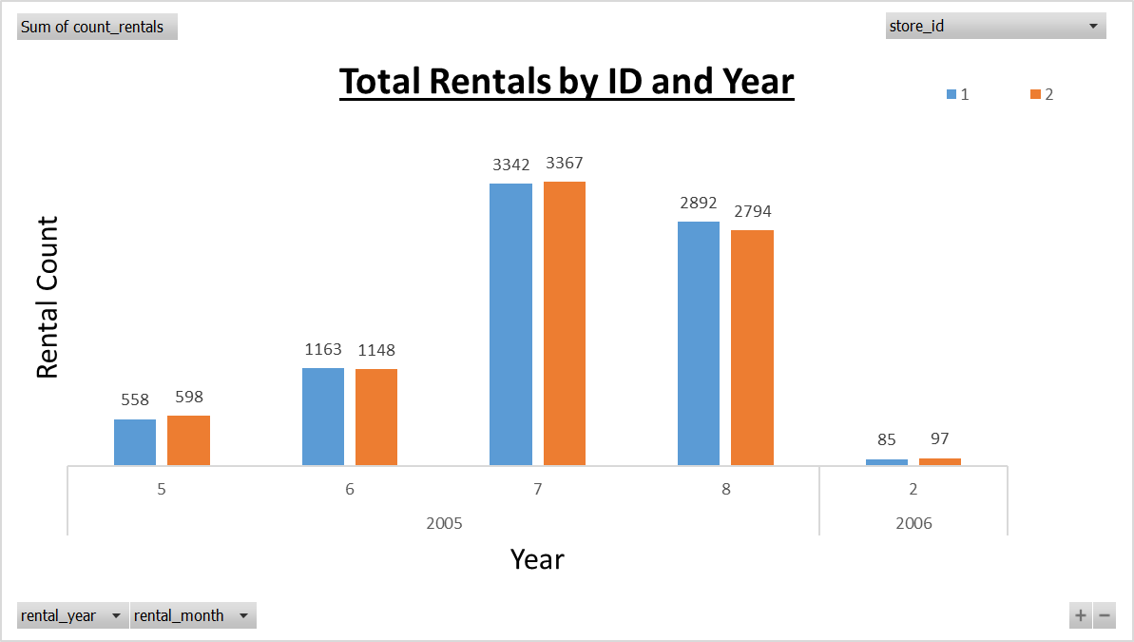
Q.3 How do stores compare in their rental count during every month for all the data available?
Both stores have similar rental counts however store id 1 has a total of 8,040 whereas store id 2 has a total of 8,004.

Slide 4
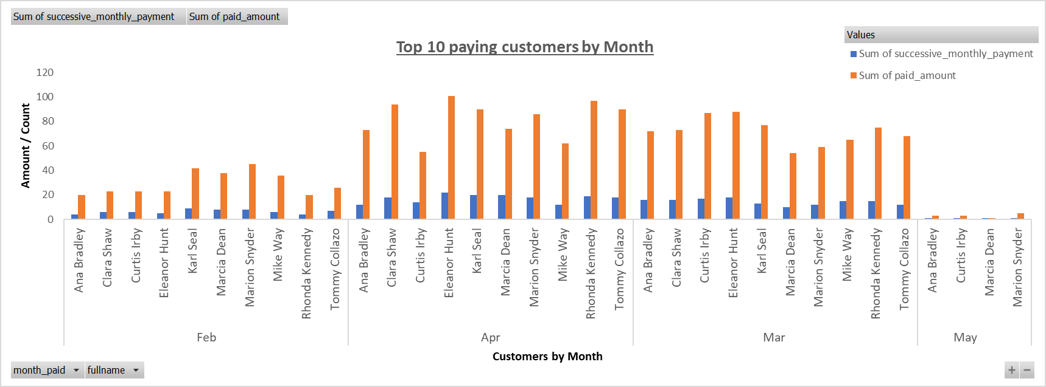
Q.4 Which top 10 paying customers made monthly payment during 2007 and what amount?
March and April had the highest payment months Eleanor Hunt had the highest payments amount for both those months. May was the lowest and only had 4 out of 10 top paying customers.

